Slide 1





Buck Converter Based EV Charging System
Circuit & Systems Project | LTspice Simulation
AKSHAT KUMAR (12240080)
AYUSH KUMAR MISHRA (12240340)

Slide 2


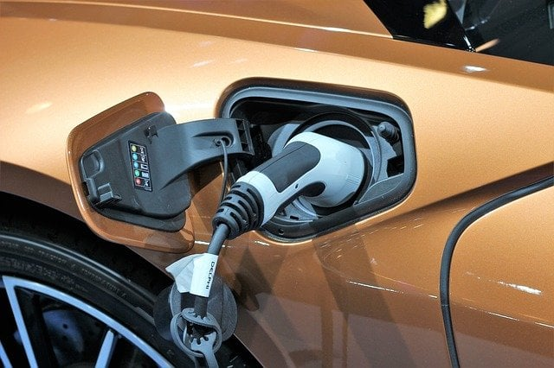
Introduction
Objective: Design and simulate a DC-DC Buck Converter for EV/E-Bike battery charging.
Converts 325V DC (rectified mains) to 48V DC.
Target output current: 3A.
Switching frequency: 50 kHz.
Validate performance using LTspice transient simulation.

Slide 3


Why Buck Converter for EV Charging?
Simple and efficient method for voltage step-down.
High power efficiency (>90% achievable).
Smooth and stable DC output suitable for battery charging.
Lower switching losses and easier control technique.

Slide 4


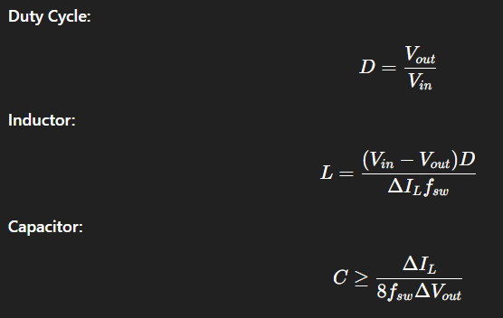

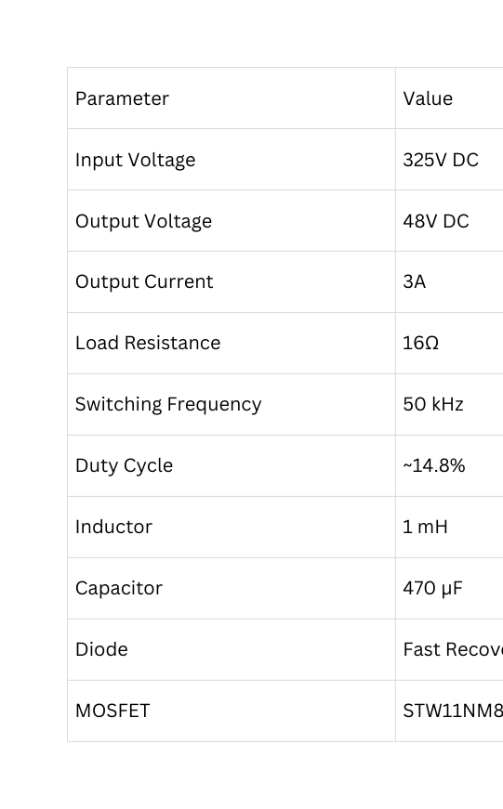
System Specifications

Slide 5

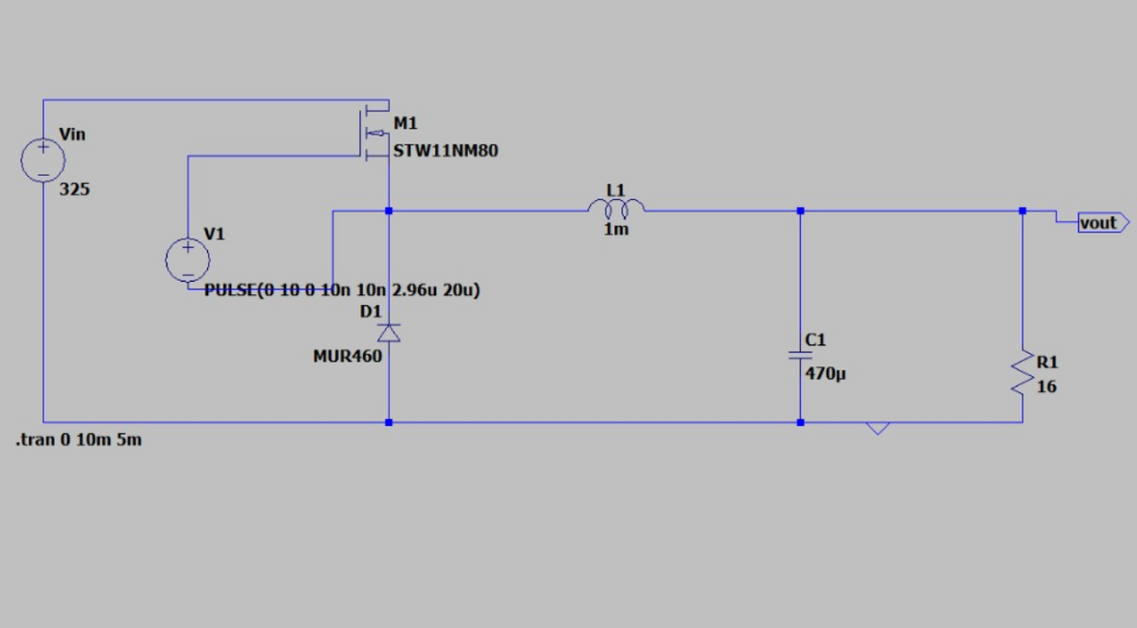
Working Principle
AND
Circuit Diagram
MOSFET ON → Inductor stores energy
MOSFET OFF → Diode conducts, inductor releases energy
Capacitor smooths ripple
Output controlled by PWM duty cycle

Slide 6
LTspice Setup
• PWM signal will be configured using the general form:
PULSE(V1, V2, Tdelay, Trise, Tfall, Ton, Tperiod)
• For this simulation: PULSE(0 10 0 10n 10n 2.96u 20u)
• Transient analysis will be performed using the general form:
.tran Tprint-step Tstop Tstart-save
• For this simulation: .tran 0 10m 5m
• Parameters to monitor: output voltage, inductor current, and switching waveforms.

Slide 7
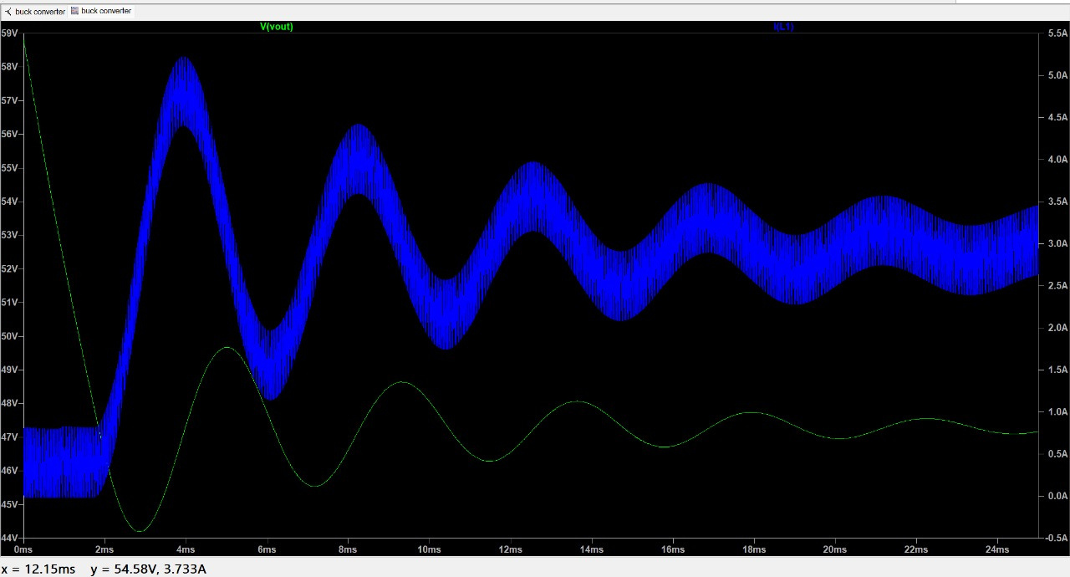
Simulation Results
Output voltage settles near 48–55V
Inductor current ~ 3A average
Ripple visible due to switching
Startup stabilization ~ 5 ms

Slide 8
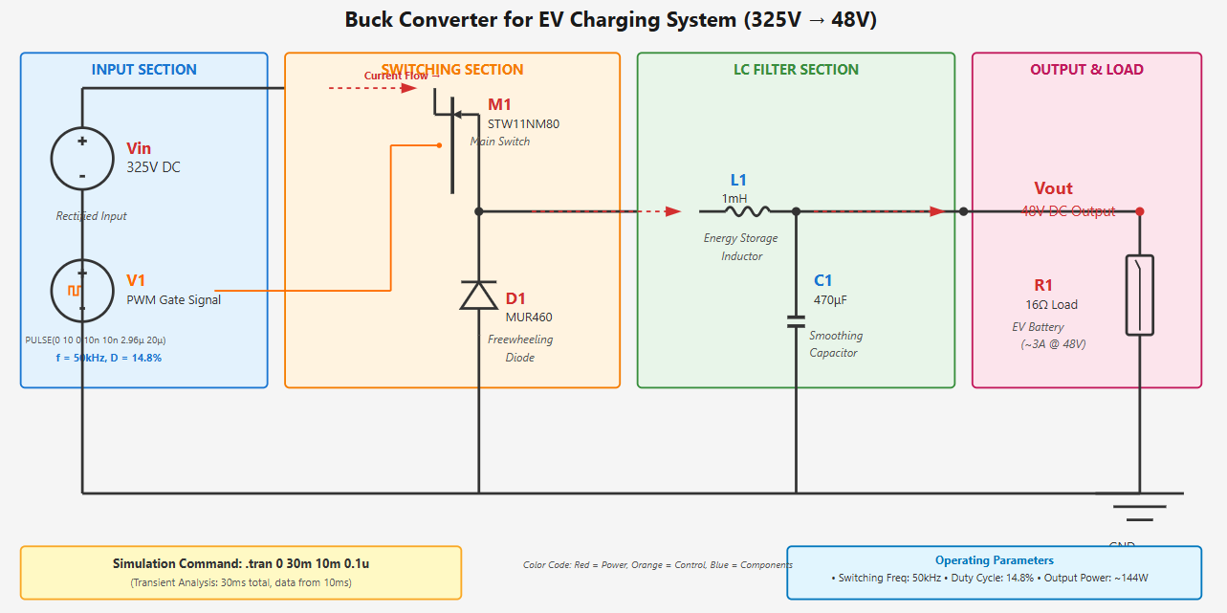

Slide 9


Conclusion
MODEL
SUITABILITY
SIMULATION
A 325V → 48V buck converter successfully modeled.
Suitable for low-power EV and E-bike charging systems.
Simulation validates correct operation and transient behavior.

Slide 10

E-bike battery chargers
Small electric vehicle charging ports
Applications
Industrial DC supplies
Solar battery charging
UPS systems

